Slide 1

Predicting Daily Temperature in New Delhi
By Justin Ehly

Slide 2


New Delhi Weather
Wet season is hot and partly cloudy.
Dry season is warm and clear
Annual temperature variance: 7⁰C-39⁰C
SOURCE: https://weatherspark.com/y/109174/Average-Weather-in-New-Delhi-India-Year-Round
SOURCE:https://www.thoughtco.com/geography-of-new-delhi-1435049

Slide 3
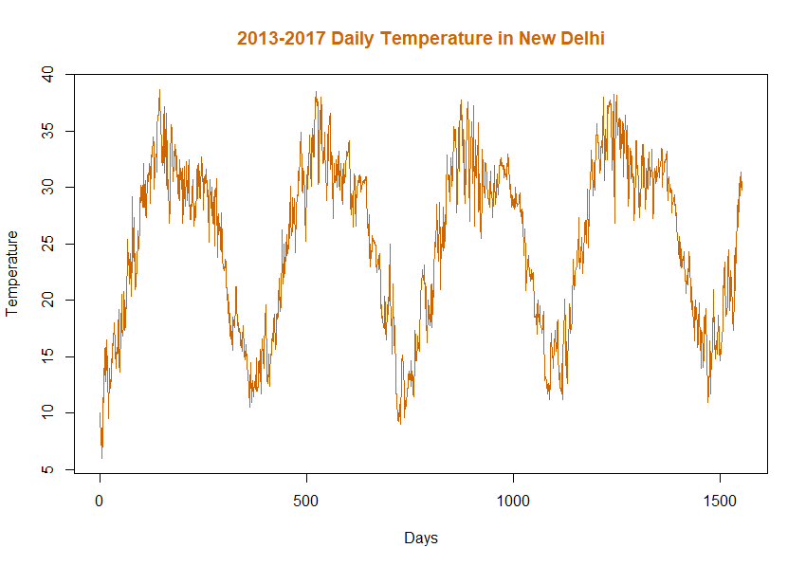
The Data
Spans 12/31/2012 – 04/24/2017
Response Variable: Mean Temperature
Exaplanatory Features:
Humidity
Mean Pressure
Wind Speed
Source: https://www.kaggle.com/datasets/sumanthvrao/train-climate-Days-series-data

Slide 4
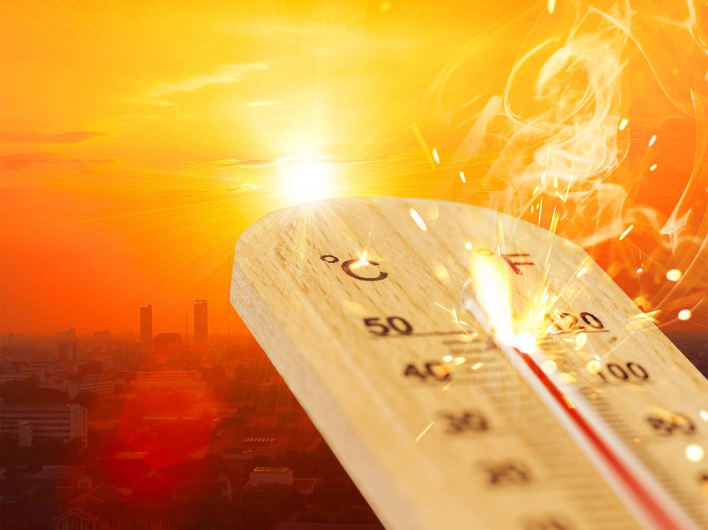
Applications
How to dress
How much water to pack
How to set the A/C

Slide 5
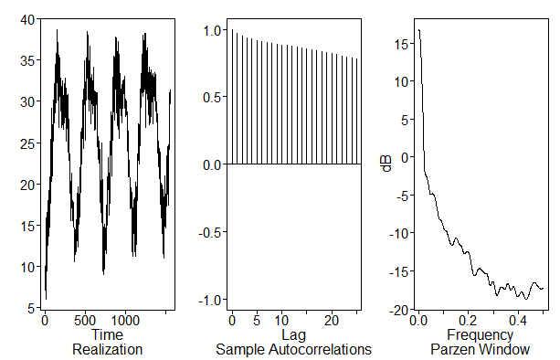
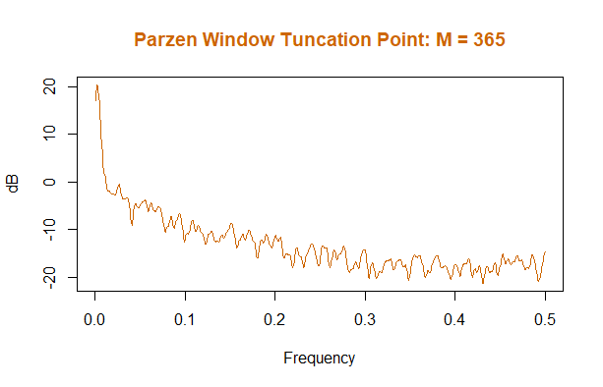
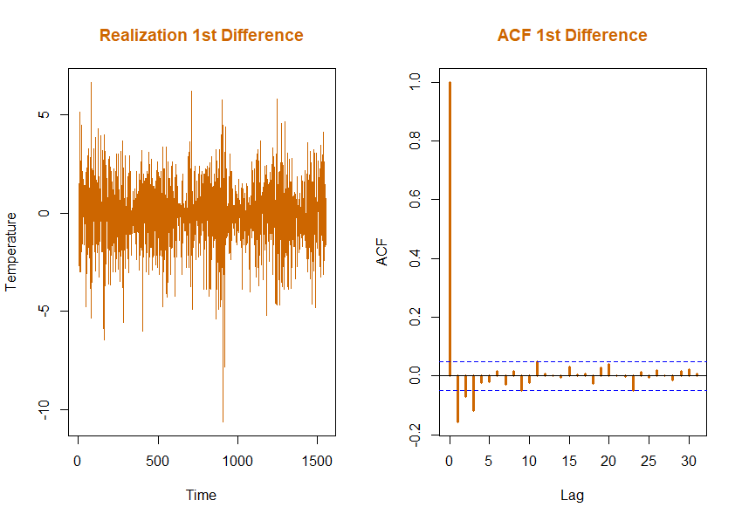
Univariate Analysis
Non-stationary
Strongest Peak:
1/0.002574 = 388.5
*note (very close to 365)
Only 1st Difference Showed Promise
*note Potential (1-B)
With additional tests, we can confirm using the ACF’s that there is no differencing at 3, 4, 6, 12, 30 or 90, 180, 365, 388.5
f = 0.0026

Slide 6
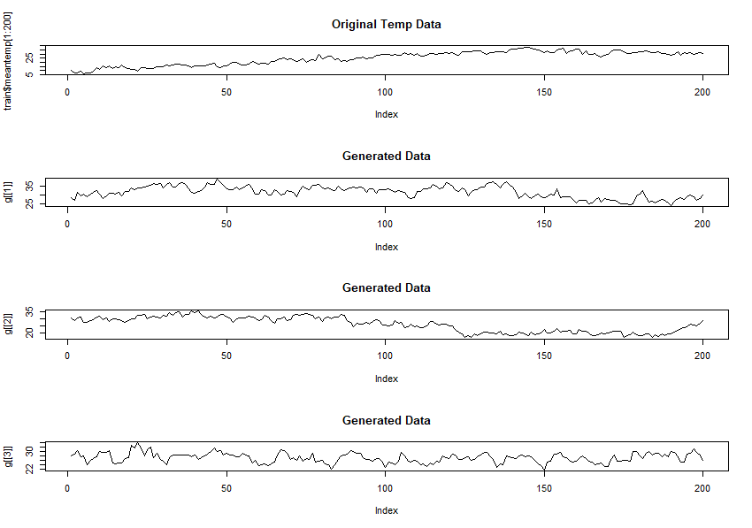
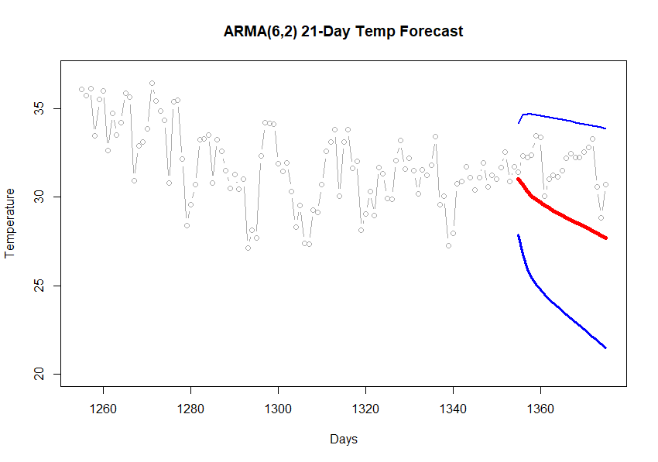
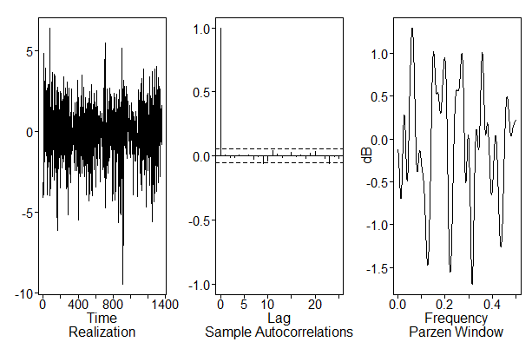
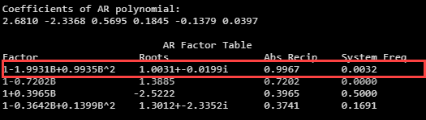

ARMA(6,2) With 21-Day Forecast
Model: $φ\left(B\right)\left(X_{t}−μ\right)= θ\left(B\right)a_{t}, σ_{a}^{2}$
First factor is REALLY close to the unit circle |r⁻¹| = 0.9967
$\left(1 −2.68B+2.34B^{2}− 0.57B^{3}− 0.18+0.14B^{5}− 0.04B^{6}\right)\left(X_{t} −25.16\right)=\left(1−1.93B+0.93B^{2}\right)a_{t},$
$σ_{a}^{2}=2.51$
ASE: 9.123
RMSE: 3.020
Rolling RMSE: 137.765
Residuals visually look like white noise
Ljung pvalues:
K=24 0.25
K=48 0.28

Slide 7
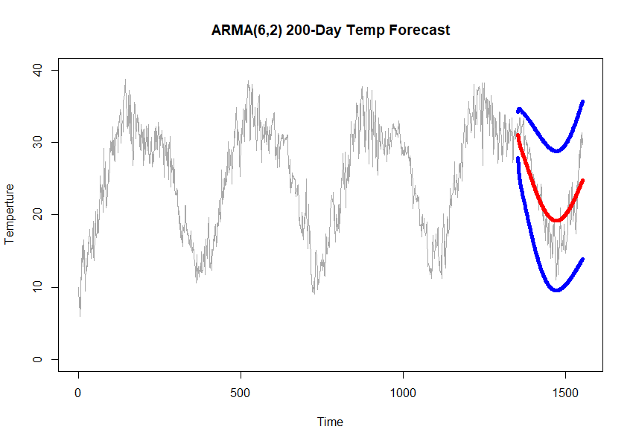
ARMA(6,2) 200-Day Forecast
ASE: 9.882
RMSE: 3.143
Rolling RMSE: 298.491

Slide 8
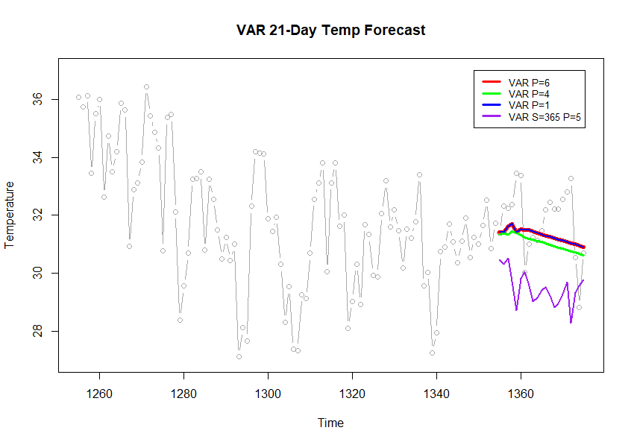
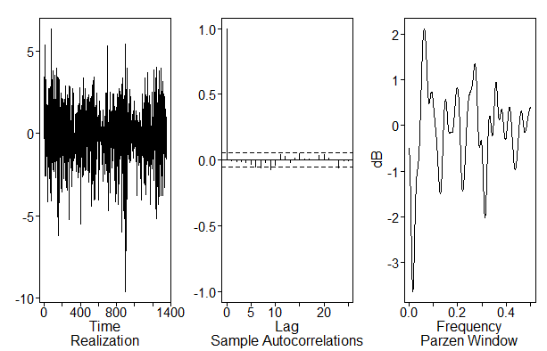
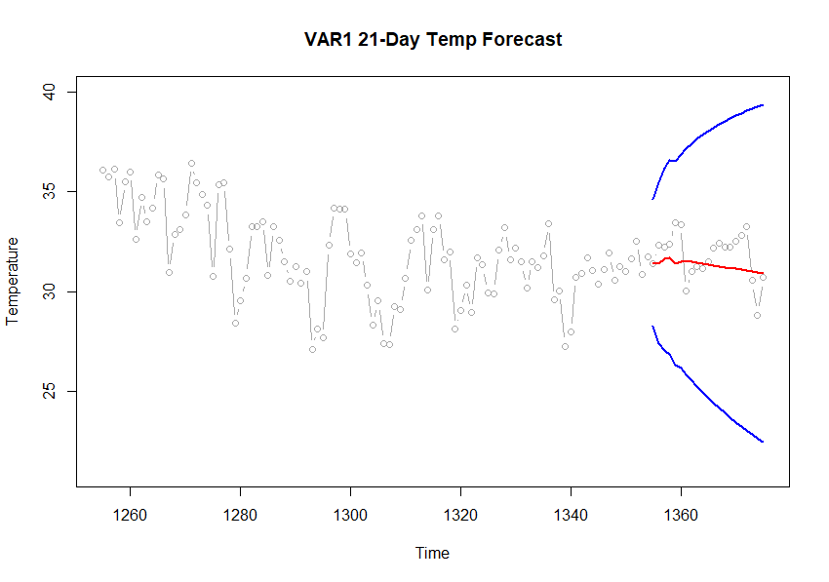
VAR 21-Day Forecast
VAR p=6 AIC
ASE:1.46 RMSE: 1.208
VAR p=4 HQ(n)
ASE:1.724 RMSE: 1.313
VAR p=1 BIC
ASE:1.46 RMSE: 1.208
VAR S=365 p=5 Justin Model
ASE:7.24 RMSE: 2.692
Visually not white noise
Ljung p-values:
K=24 0.032
K=48 0.044
More modeling to be done…

Slide 9
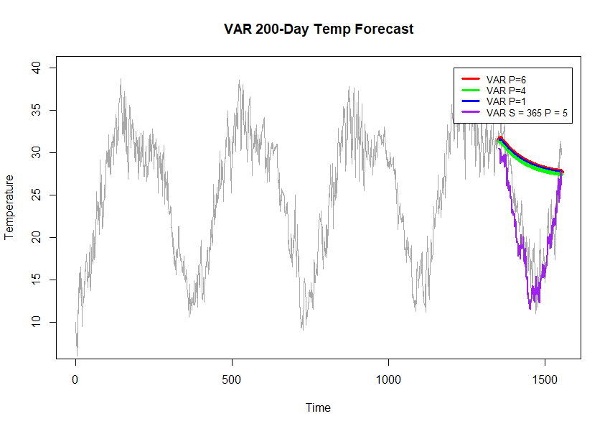
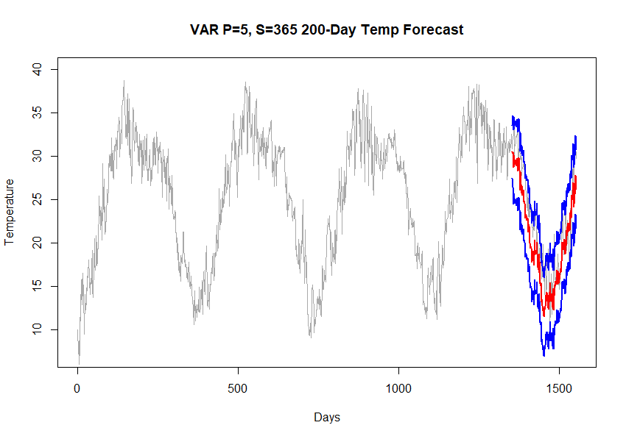

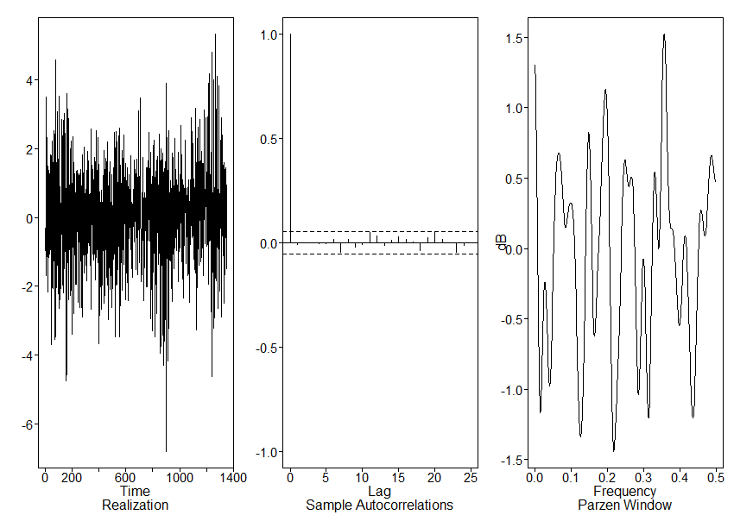
VAR 200-Day Forecast
VAR p=6 AIC
ASE: 73.06, RMSE: 8.55
VAR p=4 HQ(n)
ASE: 68.77, RMSE: 8.29
VAR p=1 BIC
ASE: 52.12, RMSE: 7.22
VAR S=365, p=5 Justin Model
ASE: 9.39, RMSE: 3.06
Visually looks like white noise
Ljung p-values:
K=24 0.395
K=48 0.066

Slide 10
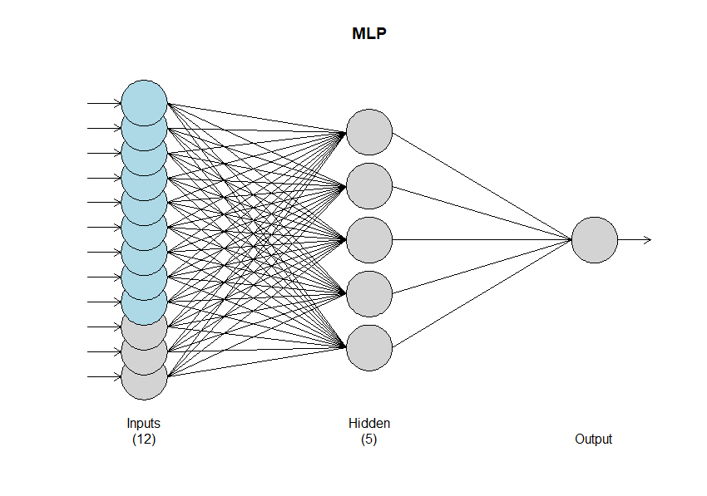
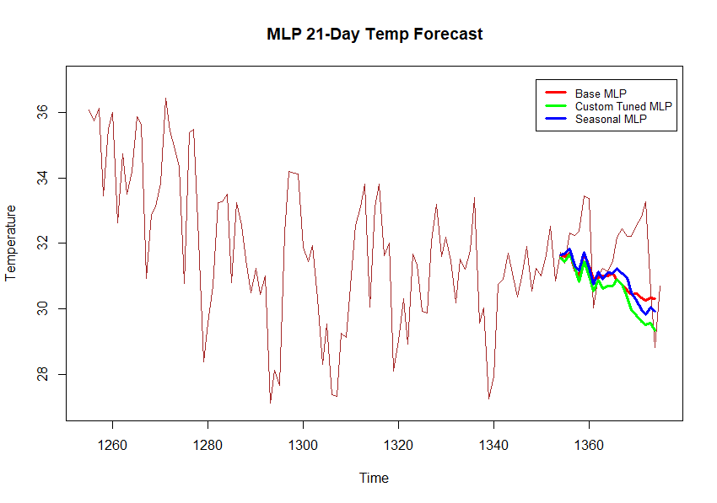
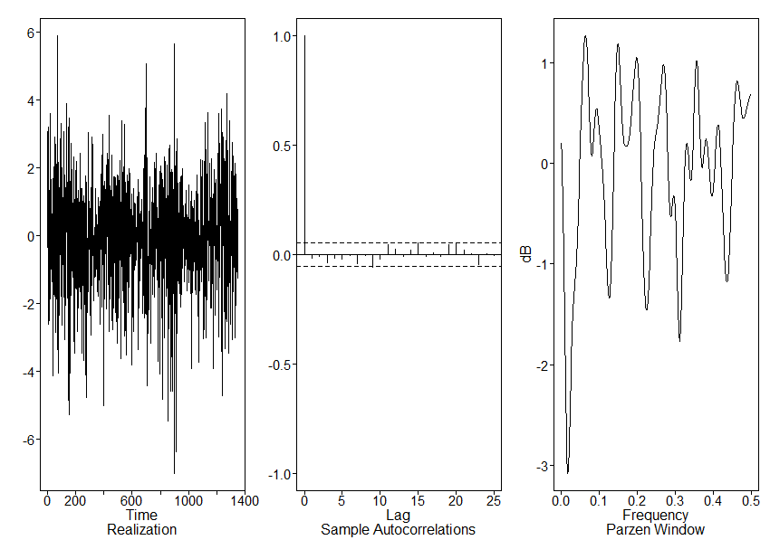
MLP 21-Day Forecast
BASE MLP
ASE: 2.017, RMSE: 1.42
FIT MLP
ASE: 2.741, RMSE: 1.656
Seasonal MLP
ASE:1.957, RMSE: 1.399

Slide 11

MLP 21-Day Forecast
Seasonal MLP
5 Hidden nodes and 20 repitions
Univariate lags: (1,4,7)
Regressor 1 lags: (1,2,4,6)
Regressor 2 legs: (1,3,6)
Regressor 3 lags: (2,5)
MSE: 2.24
BASE MLP
ASE: 2.017, RMSE: 1.42
FIT MLP
ASE: 2.741, RMSE: 1.656
Seasonal MLP
ASE:1.957, RMSE: 1.399
Visually residuals appear to be white noise
Ljung using HD in place of p,q
K=24 0.059
K=48 0.142

Slide 12
MLP 21-Day Forecast
Visually residuals appear to be white noise

Slide 13
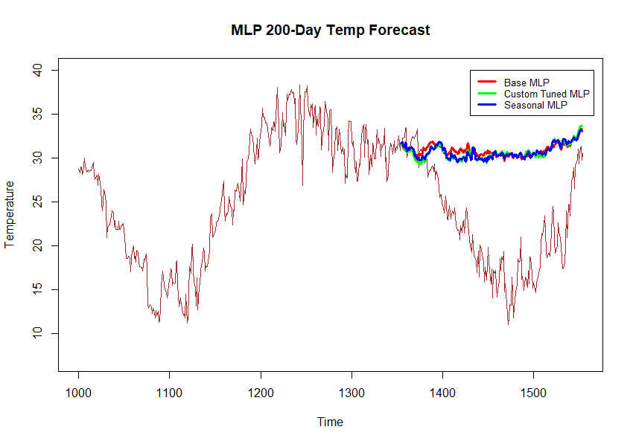
MLP 200-Day Forecast
BASE MLP
ASE: 104.36, RMSE: 10.21
FIT MLP
ASE: 102.96, RMSE: 10.03
Seasonal MLP
ASE: 102.48 RMSE: 10.15

Slide 14
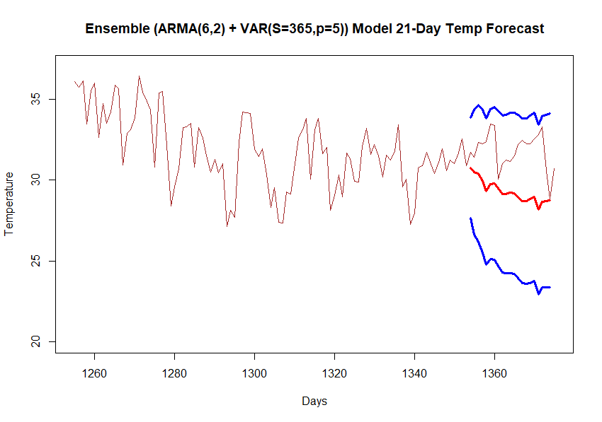
Ensemble 21-Day Forecast
ARMA(6,2) + VAR(S=365,p=5)
ASE: 7.992
RMSE: 2.827

Slide 15
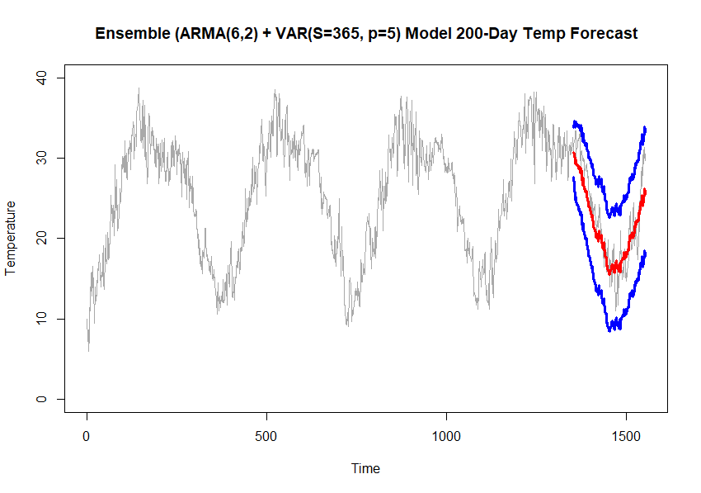
Ensemble 200-Day Forecast
ARMA(6,2) + VAR(S=365,p=5)
ASE: 6.448
RMSE: 1.975

Slide 16
Final Model Comparison
Models | ASE 21-Day | RMSE 21-Day | ASE 200-Day | RMSE 200-Day
ARMA(6,2) | 9.525 | 3.086 | 9.883 | 3.14
VAR(p=1) | 1.46 | 1.208 | 73.065 | 8.548
VAR(S=365,p=5) | 7.248 | 2.692 | 9.386 | 3.064
MLP-Seasonal | 102.479 | 1.399 | 102.479 | 10.123
Ensemble | 7.992 | 2.827 | 6.448 | 1.975

Slide 17
Thank You.
Justin Ehly, jehly@smu.edu

